Slide 1


Transforming Urban Response with BAPU
BAPU: Behavioural Analysis & Prediction Unit

Slide 2

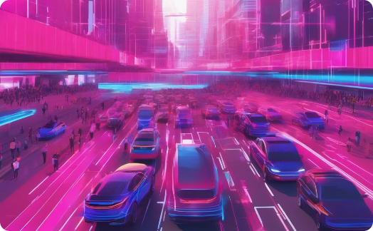

BAPU: Behavioural Analysis & Prediction Unit
Predictive Location Modeling
Practical Applications
Innovative Approach
Leveraging insights to enable proactive traffic and emergency management, improving safety and efficiency.
Combining predictive analytics and IoT to drive sustainable urban solutions.
Forecasting and discovering behavioural patterns to optimize mobility.

Slide 3
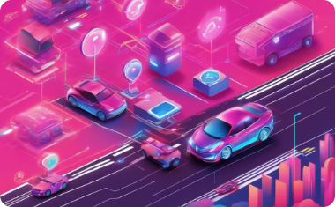



Innovative Approach
ANPR Data Utilization
Pattern Analysis
Outlier Identification
Adrenaline Impact
Method in the Madness
Comprehensive view of vehicle movements across regions
Apply statistical methods and machine learning
Incorporate behavioral insights into predictive modeling

Slide 4

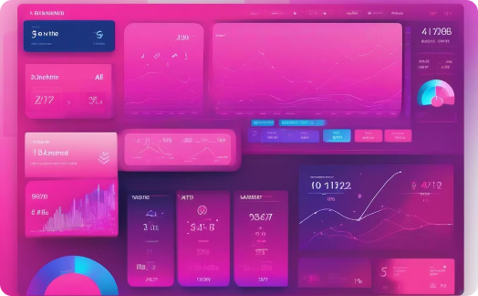
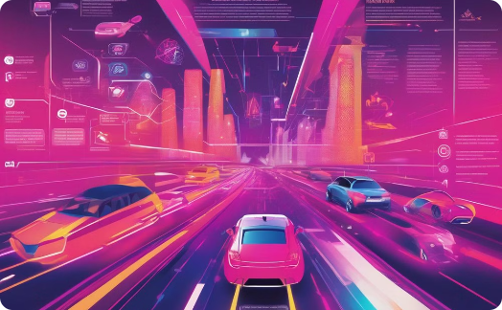
Predictive Location Modeling
Historical Analysis
Real-Time Prediction
Behavioral Integration
Learn typical routes from past ANPR data
Forecast future locations based on current patterns
Include adrenaline-influenced driving in predictions

Slide 5




Innovative Edge
Behavioral Science + Tech
Real-Time Analytics
Scalability
Provide up-to-the-minute predictions for operations
Expand across regions, integrate more data sources
Integrate adrenaline impact with machine learning

Slide 6



Expected Outcomes with further data
Optimized Traffic Flow
Efficient Resource Allocation
Increased Public Safety
Reduced congestion and improved travel times
Enhanced monitoring and response to threats
Better deployment of law enforcement resources

